Slide 1
Chapter 4
PID Control

Slide 2
PID control
PID control used world-wide.
Survey, 95% industrial controllers are PID
Advantages:
very effective
very simple to implement and easy to use
wide Applications
robust, insensitive to changes to plant parameter and disturbance.
Exceptions:
On/off control for those with low control requirement loops
Advanced control for systems and with high control requirements.
Process Control
Prof. Cai Wenjian

Slide 3
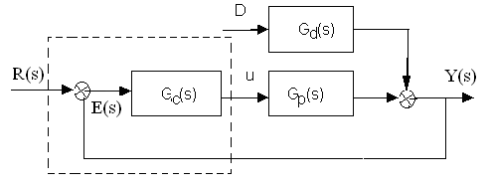
Closed-loop Control Objectives
Stability and stability robustness, measured in the frequency domain
Transient response, rise time, overshoot, and settling time
Steady-state accuracy
Disturbance attenuation and robustness against environmental uncertainty at steady state
Robustness against plant modeling uncertainty, measured in both time and frequency domain.
Process Control
Prof. Cai Wenjian

Slide 4
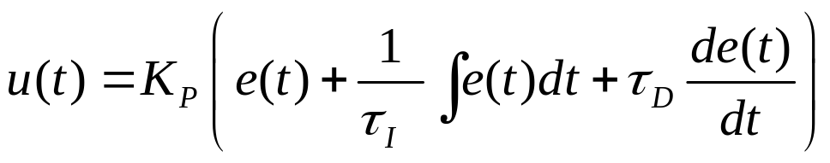


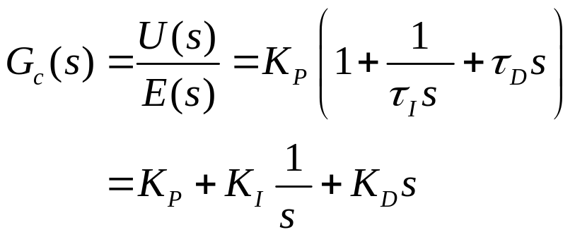
PID Controller Forms
Ideal form
K_{P}: proportional gain,
: integral time constant,
: derivative time constant
K_{I}: Integral gain,
K_{D}: Derivative gain,
Process Control
Prof. Cai Wenjian

Slide 5
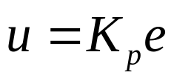
Proportional Function
Controller output u proportional to error signal e:
P control has steady state error.
Example: Control of heating system
Line 1: static property of P controller
Line 2 and 3 static properties of heater at different flow rate
Point O is initial steady state Q_{o}, θ_{o} and μ_{o}.
If flow rate reduced to Q₁, new steady state A.
Error θ_{A} - θ_{o} because of P control, much better.
Process Control
Prof. Cai Wenjian

Slide 6
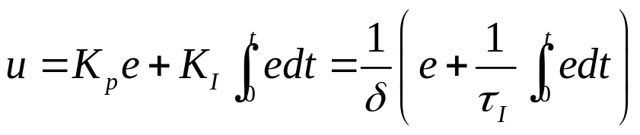
Integral Function
Controller output is proportional to error e.
I regulation alone is rarely used, mostly combined with P to form PI;
P improve response, reject disturbance;
I eliminate steady state error.
Property 1: e=0, output of I control is constant, no steady state error.
Process Control
Prof. Cai Wenjian

Slide 7
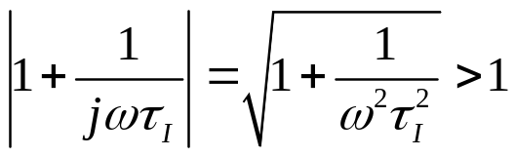
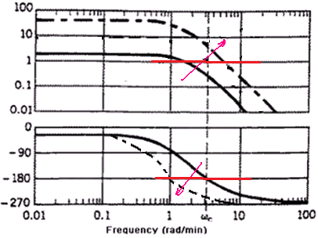

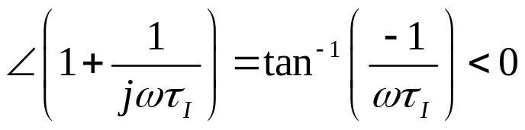

Destabilizing Effect of Integral Term
Property 2:, I is always slower than that of P control, reduce system stability
Adding integral to proportional term, increases gain
increases phase-lag
both GM,PM are reduced, closed-loop system more oscillatory, potentially unstable.
Property 3: Open loop gain proportional to K_{I}, increase K_{I} reduce system stability.
Process Control
Prof. Cai Wenjian

Slide 8
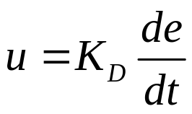
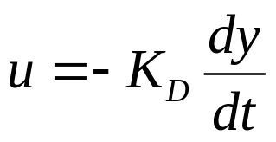
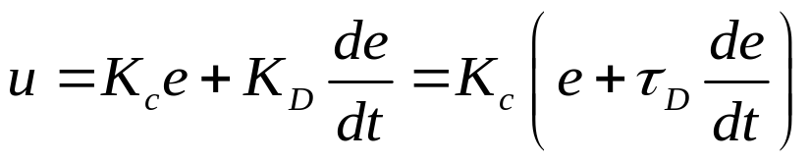
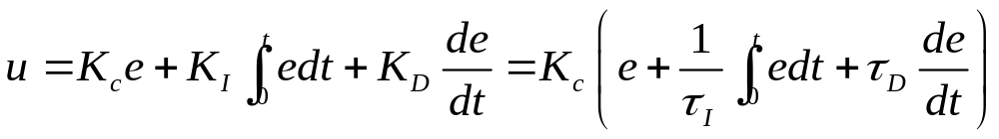
Derivative Function
Output of controller is proportional to the differential of error
or
Prediction: Adjusting the output according to speed of error.
D function must be formed to PD or PID controllers.
Controller takes no action if rate of change very small, accumulate error.
Process Control
Prof. Cai Wenjian

Slide 9
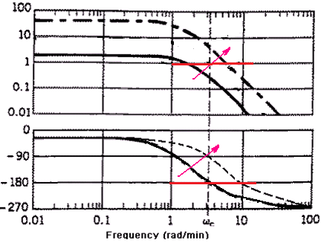

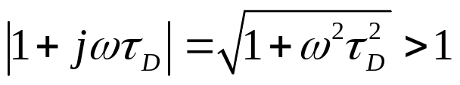
Properties of Derivative Action
Property 1: Increase τ_{D} increase stability, but unstable if τ_{D} value over certain limit
Adding D to P term, reduce phase lag
Increase PM
Increase gain
Uncertain GM
Overall stability may be improved or degraded
Property 2: Steady state, de/dt=0, PD control has steady state error.
Property 3: D function reduces oscillation, increases system stability?
Property 4: D increase response speed, but sensitive to disturbance.
Process Control
Prof. Cai Wenjian

Slide 10
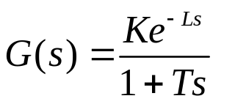
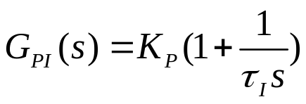
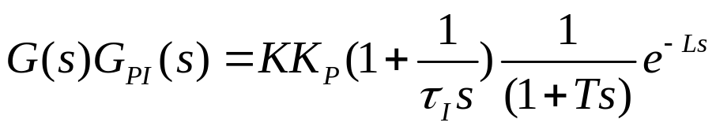
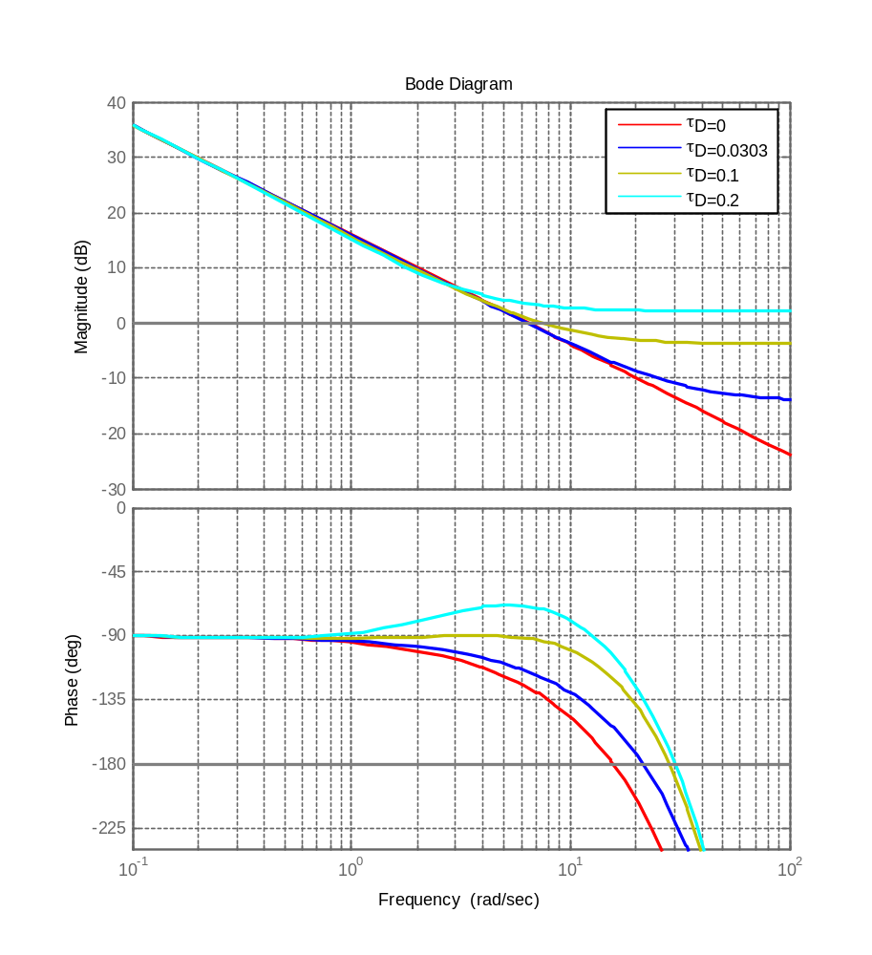

Example
Forward path transfer function with frequency response
Process Parameters: K =10,
T =1s, L =0.1s
Controller parameters:
K_{P}=0.644>1/K,
Controller has good stability margins (red)
Process Control
Prof. Cai Wenjian

Slide 11
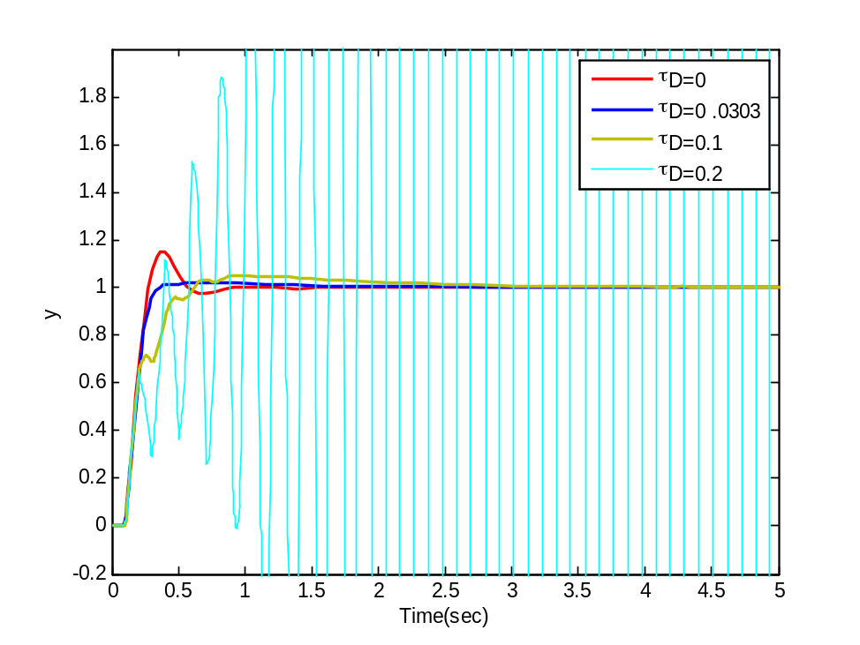
Example
Adding a derivative term initially increases both GM and PM,
Raising derivative gain further reverse GM, destabilize closed-loop system.
Up to 20% of proportional gain (0.2 s), overall open-loop gain >2.2 dB for all ω. At ω = 30 rad/s, phase decreases to −π, by Nyquist criterion, system unstable.
Time-domain performance
Process Control
Process Control
Prof. Cai Wenjian
Prof. Cai Wenjian

Slide 12
Summary
Proportional: makes control proportional to error signal by all pass gain factor.
Integral: reduces steady-state errors through low-frequency compensation.
Derivative: improves transient response through high-frequency compensation.
 | Rise Time | Overshoot | Settling Time | Steady-State Error | Stability
Increasing K_{P} | Decrease | Increase | Small Increase | Decrease | Degrade
Increasing K_{I} | Small Decrease | Increase | Increase | Large Decrease | Degrade
Increasing K_{D} | Small Decrease | Decrease | Decrease | Minor Change | uncertain
Process Control
Prof. Cai Wenjian

Slide 13
Popular Methods
Heuristic: evolve from empirical tuning (such as Z­N tuning rule), tradeoff among design objectives.
Frequency Response: Frequency-domain constraints, such as gain margin (GM), phase margin (PM), and sensitivities.
Analytical: derived using algebraic relations, such as pole placement, internal model control (IMC), or lambda tuning.
Numerical Optimization: parameters are obtained by numerical optimization for a weighted objective in the time domain.
Process Control
Prof. Cai Wenjian

Slide 14
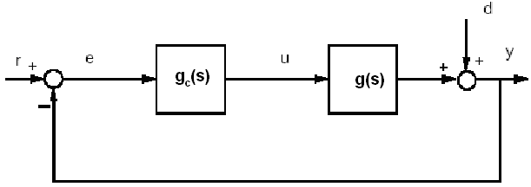


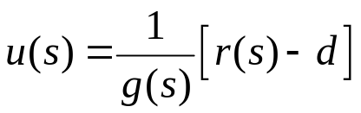

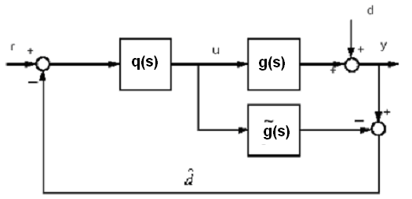


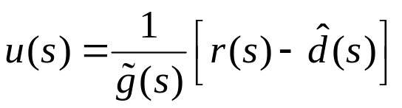
IMC Motivation
"perfect" control,
However, d unmeasured and g approximated
Assuming
Then near perfect control
Process Control
Prof. Cai Wenjian

Slide 15
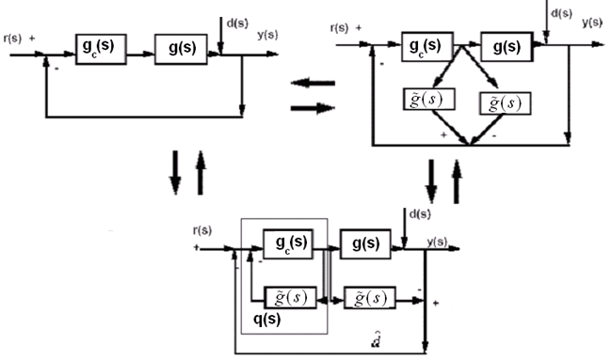
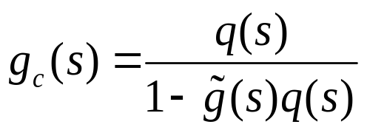
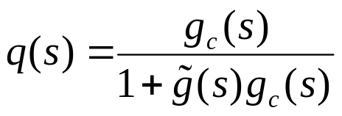
Equivalent Relationship
q(s) and g_{c}(s) obtained via algebraic transformations, and vice-versa
Process Control
Prof. Cai Wenjian

Slide 16

Property: Internal Stability
Assume a perfect model
The IMC system is internally stable (IS)
if and only if both g and q are stable.
Assume that g is stable and
the classical feedback system with controller determined above is IS if and only if q is stable.
Process Control
Prof. Cai Wenjian

Slide 17


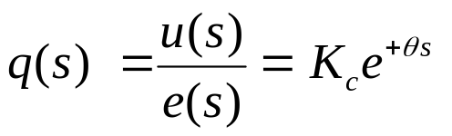

Physical Realizability
Stability: all poles of q must lie in the open Left-Half Plane.
Properness: q(s) be proper,
strictly proper: denominator order greater than the numerator order.
Semiproper: if the denominator order is equal to the numerator order.
Causality: q(s) must be causal, controller must not require prediction. a noncausal transfer function is the inverse of a time delay transfer function
Process Control
Prof. Cai Wenjian

Slide 18




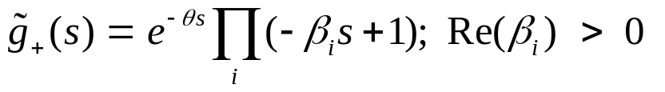
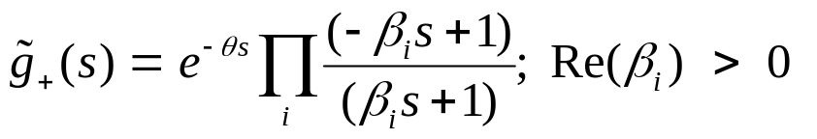
Design -- Step 1: Factoring the model
Factor the model
contains all Nonminimum Phase Elements, RHP zeros and time delays.
The factor
is stable and causal.
Initial IMC controller defined as
The factorization of
dependent upon the objective function
Example
Integral-Absolute-Error (IAE)-optimal for step setpoint/disturbance changes.
is Integral-Square-Error (ISE)-optimal for step set point/output disturbance changes.
Process Control
Prof. Cai Wenjian

Slide 19

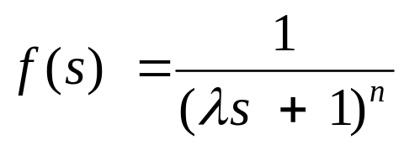
Design –Step 2: Making Controller Proper
Augment q with a filter f(s) such that the final IMC controller proper
A common filter choice that conforms to this requirement
Process Control
Prof. Cai Wenjian

Slide 20

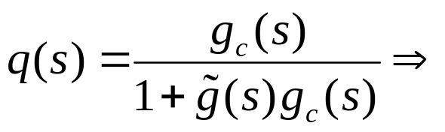
Design –Step 3: Convert to Normal Form
Converted to the conventional form for implementation
Process Control
Prof. Cai Wenjian

Slide 21
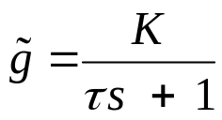
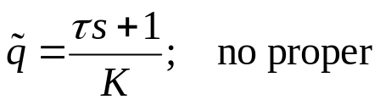

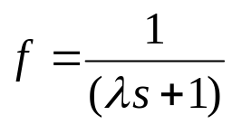
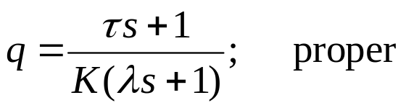
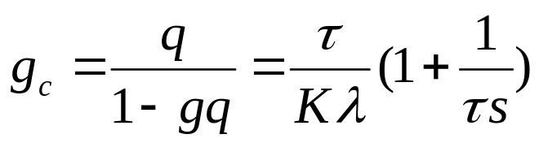
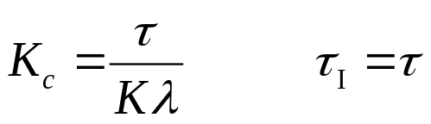
PI Control for the First Order Model
τ > 0
under the condition that d and r are step input changes.
Step 1: Factor and invert
Step 2: Augment with a first-order filter
Step 3: solve for the classical feedback controller equivalent c(s) to obtain
Process Control
Prof. Cai Wenjian

Slide 22
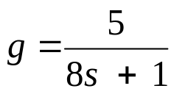
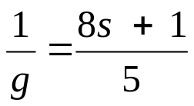
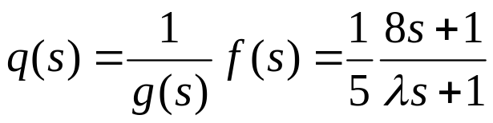
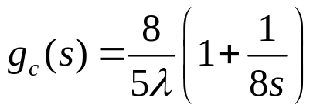
Example: First Order Process
No proper, thus:
Convert this controller to the convenentional feedback form
a PI controller whose gain depends on the filter parameter
Process Control
Prof. Cai Wenjian

Slide 23
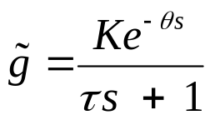

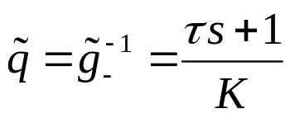

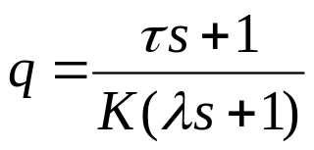
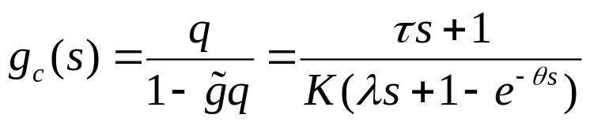
Deadtime Control
step setpoint/output disturbance changes to the closed-loop system.
Step 1: The optimal factorization (IAE, ISE, or otherwise)
Step 2: A first-order filter makes q semiproper;
Step 3: The corresponding feedback controller is
Process Control
Prof. Cai Wenjian

Slide 24


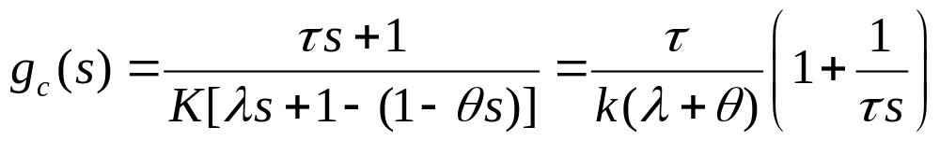
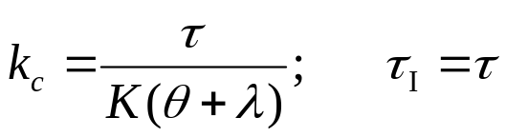
PID Tuning for FOPTD Plants
Taylor approximation
A PI controller with
Process Control
Prof. Cai Wenjian

Slide 25
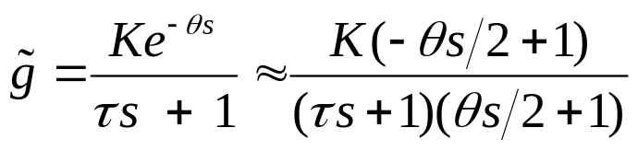
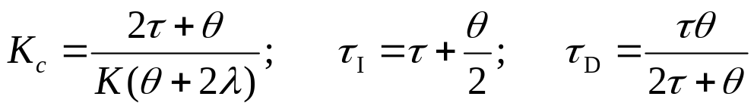


PID Tuning for FOPTD Plants
Padè-approximation
a second-order plant with RHP zero: PID tuning rule:
is a measure related to robustness of the closed-loop system.
IMC-PID controller results in an ISE value 10% more than optimal.
Process Control
Prof. Cai Wenjian

Slide 26
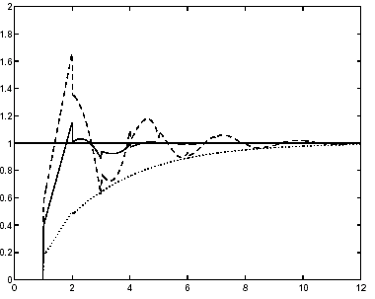




IMC-PID responses for a step setpoint change, for various settings of
solid:
dotted:
dashed:
.
Process Control
Prof. Cai Wenjian

Slide 27










Gain and Phase Crossover Frequency
.
gain margin at phase crossover frequency
phase margins at the gain crossover frequency
Process Control
Prof. Cai Wenjian

Slide 28


Gain and Phase Margin Design
Gain and phase margins normally specified between 2 to 5 and 30⁰-60⁰ for best compromise between performance and robustness
Given
Four designing equations
Five unknown parameters, i.e., K_{p}; K_{i}; K_{d};
Specified one parameter, design reduce to solving four nonlinear algebraic equations for remaining four unknown parameters.
Process Control
Prof. Cai Wenjian

Slide 29





Simplified Design-Problem Formulation
Model
PID controller
Selecting
Open loop transfer function becomes
Process Control
Prof. Cai Wenjian

Slide 30

Simplified Design-Problem Formulation
Substituting into the four equations
Process Control
Prof. Cai Wenjian

Slide 31



Gain and Phase-Solution From
Process Control
Prof. Cai Wenjian

Slide 32










Gain and Phase-Solution From
 | 2 | 3 | 4 | 5
Process Control
Prof. Cai Wenjian

Slide 33






Working Example (Z-N)

Slide 34






Working Example (Cohen-Coon)

Slide 35









Working Example (ITAE)
Set-point tracking:
Disturbance rejection:

Slide 36





Working Example (Direct Synthesis)
Pade approximation:

Slide 37









Working Example (IMC)
Pade approximation:

Slide 38




Working Example (GPM)
Choose gain margin A_{m}=3

Slide 39


Slide 40


